Slide 1
The Case for a Threshold Bennett S. Greenspan, MD, MS, FACNM, FACR, FSNMMI, FAAPM Immediate Past President, SNMMI ANS & HPS Applicability of Radiation Response Models to Low Dose Protection Standards Tri-Cities, Washington October 2, 2018

Slide 2
Disclosure
I do not have a financial interest, arrangement or affiliation, including receipt of honoraria or expenses from a commercial organization, that could have a direct impact in the subject matter of my presentation.

Slide 3
Case for a Threshold – LNT is Wrong
Linear No-Threshold hypothesis (LNT) is wrong
1. LNT claims cancer risk extends down to zero. But there has never been evidence to show increased risk below 100 mSv (10 rem) and probably 200 mSv (20 rem).
2. Whether or not low-dose damage is linearly proportional to dose, the defense response is nonlinear. DNA repair involves >150 genes, antioxidant production, apoptosis, bystander effects, and immune system response.
3. LNT excludes evolutionary biology. There are differing responses to high-dose vs. low-dose exposure.

Slide 4
Case for a Threshold – LNT is Wrong
4. LNT assumes radiation damage and associated cancer risk accumulate throughout life. – Not true, as this ignores repair of DNA damage as well as cellular turnover and elimination.
5. LNT assumes radiation induced-risk is independent of dose rate. Not true – radiation therapy is based on different responses due to different dose rates.
6. LNT assumes a single mutation will lead to cancer. – Not true. Development of malignancy requires multiple mutations and deficiencies of the body’s defense mechanisms as well as immune system failure.
7. No evidence of harm with higher background rates, up to at least 260 mSv (26 rem).

Slide 5
Case for a Threshold – Radiation Hormesis
Radiation hormesis is real
Many substances - drugs, vitamins, trace metals, are beneficial at low levels but toxic at high levels
Atom bomb survivors – exposures at 0.5-1.5 Sv (50-150 rem) – less nonmalignant disease; Leukemia – hormesis with threshold of 500 mSv (50 rem)
Cancer risk is below baseline at approximately 0.15 Gy weighted colon dose

Slide 6
Case for a Threshold - Hormesis
Fluoroscopy of Canadian TB patients with doses of 50-300 mGy (5-30 rad) – 1/3 less breast cancer
Fluoroscopy of Massachusetts TB patients (mean dose 0.61-1.12 Gy [61-112 rem]) had markedly less mortality from lung cancer, compared to unexposed controls. However, breast cancer was increased (mean dose 0.54-0.96 Gy [54-96 rem]) Ref: Davis, et al, Cancer Research 49: 6130-6136, 1989

Slide 7
Case for a Threshold - Hormesis
Protracted exposure of low level radiation <2 Gy (200 rem) does not increase risk of lung cancer.
The natural incidence of lung cancer is actually reduced.
Ref: Rossi, Zaider, Radiat Environ Biophys 1997 Jun;36(2):85-88

Slide 8
Case for a Threshold - Hormesis
Nuclear power workers (over 400,000, 154 facilities, 15 countries) decreased risk of malignancy
Mayak incident – individuals with exposures of 0.04, 0.12 and 0.5 Sv (4, 12 and 50 rem) – less cancer than individuals not exposed. At 0.5 mSv (50 rem) cancer mortality was 29% less than controls
Over 7200 Taiwan apt dwellers exposed to 48 mSv – fewer cancers than unexposed controls

Slide 9
Case for a Threshold - Hormesis
Radiation hormesis is real
Chronic exposure to low dose ionizing radiation induces DNA damage response, accumulated DNA damage only occurred in more highly exposed subjects; => suggestive of radiation hormesis. Ref: Gaetani et al. Occup Environ Med 2018 doi: 10.1136/oemed-2018-105094
Derived standardized mortality rates for cancer and circulatory disease in French nuclear works are <1, suggestive of hormetic effects/adaptive response Ref: Scott B Dose Response 2018 Apr-Jun; 16(2): 1559325818778702 online 2018 May 28. doi: 10.1177/ 1559325818778702

Slide 10
Case for a Threshold
Thresholds
Everything has a threshold – drugs, vitamins, trace metals, other chemicals
Radiation is a natural entity of the environment, why should radiation be different?
Low dose radiation is beneficial, and high dose is harmful, there must exist a threshold between them.

Slide 11
Case for a Threshold
Known thresholds for deterministic effects
Cumulative dose Gy
Pancytopenia 20
Sterility, men (temporary) 15
Sterility, women 6
Cataracts 7.5
Ref: Sanders 2017

Slide 12
Case for a Threshold
Non-human data –
Beagle dogs that inhaled plutonium dioxide – threshold of approximately 150 - 400 mSv (15-40 rem) Ref: Fisher and Weller, Health Phys. 99(3):357-362, 2010
Mutations in fruit flies – threshold of 500 mGy (50 rad). Mutation rate similar to unexposed fruit flies.

Slide 13
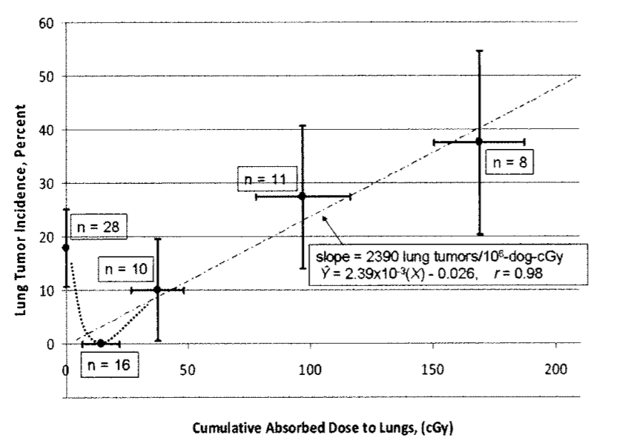
Case for a Threshold
Ref: Fisher and Weller, Health Phys. 99(3):357-362, 2010

Slide 14
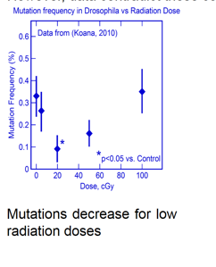
Case for a Threshold
Courtesy of Mohan Doss

Slide 15
Case for a Threshold
Thresholds for carcinogenesis
Transformation of human fibroblasts – threshold of approximately 20 rem
Secondary cancers following radiation therapy – latent period minimum approximately 5-8 years, threshold at least 2-2.5 Gy (200-250 rem), it may be as high as 5 Gy (500 rem)

Slide 16
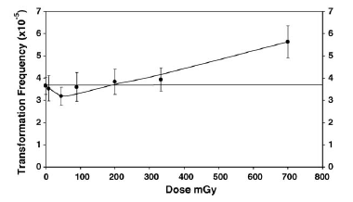
Neoplastic transformation of human fibroblasts dips below bkgd frequency at low doses Ko et al, 2006
Notes:
Ko et al, 2006

Slide 17
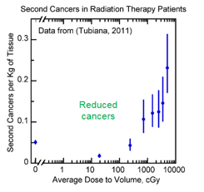
Case for a Threshold
Courtesy of Mohan Doss

Slide 18
Case for a Threshold/Hormesis
Thresholds for carcinogenesis
Nuclear power workers – no increase in mortality
Nuclear shipyard workers – 8 mSv (800 mrem) – 24% lower mortality
Plutonium workers (Manhattan Project) – decreased cancer incidence and mortality

Slide 19
Case for a Threshold
Atom bomb survivor data – threshold of up to approximately 700 mSv (70 rem)
Ref: Doss Dose Response 2013 Nov; 11(4):495-512
Atom bomb survivors – threshold for solid cancers approximately 200 mSv (20 rem) Ref: Ozasa, 2012, 2013

Slide 20
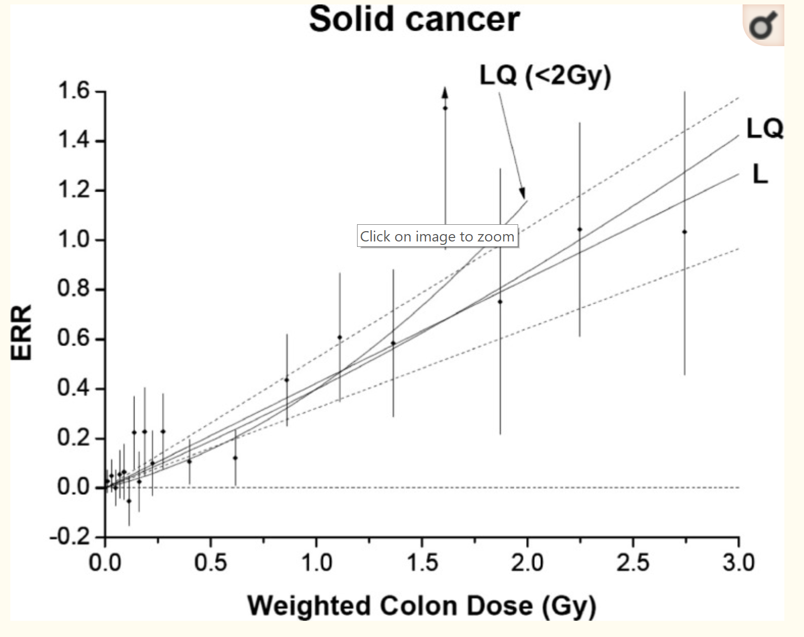
Case for a Threshold
Ref: Ozasa et al, 2012, 2013

Slide 21
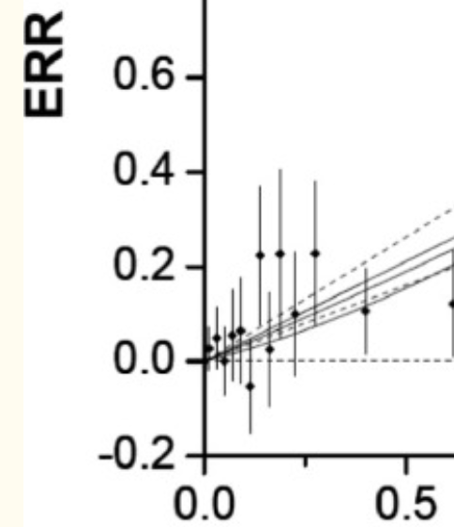
Case for a Threshold
Ref: Ozasa et al, 2012, 2013

Slide 22
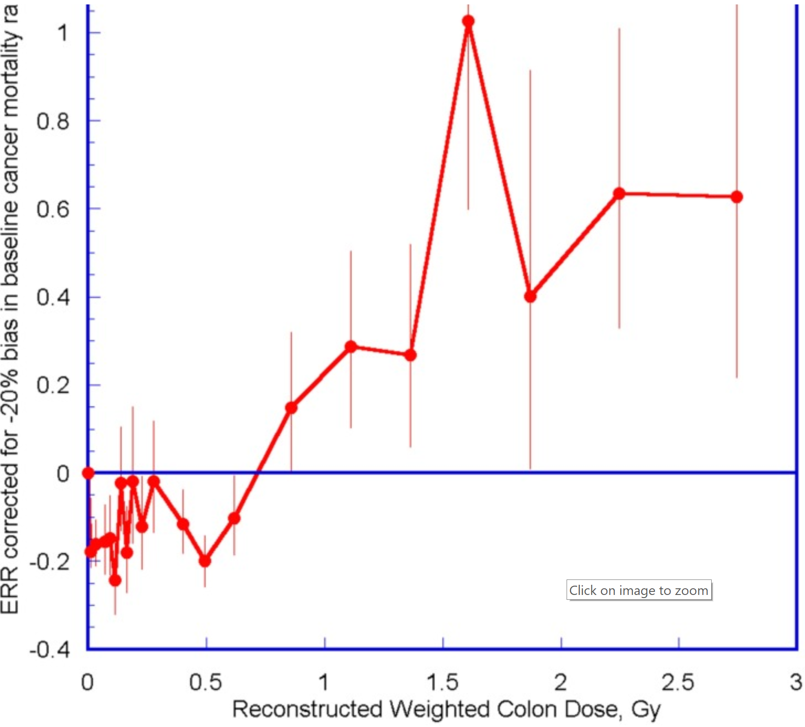
ERR for all solid cancer mortality in atom bomb survivors
Doss Dose Response 2013

Slide 23
Case for a Threshold
People who live in high background areas – no increase in cancer rate. In some areas, rates are lower.
Fluoroscopy of Canadian TB patients – no increase in breast cancer below 550 mGy (55 rem)
Hyperthyroid patients treated with I-131 – no increased risk of thyroid cancer, other solid malignancies, or leukemia. Ref: Saenger, et al, JAMA, 1968; 205(12): 855-862

Slide 24
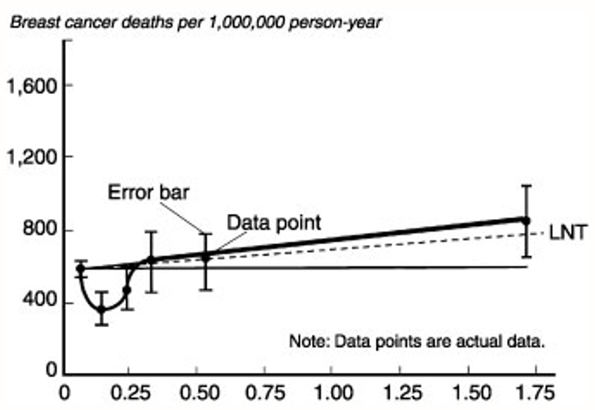
Case for a Threshold
Courtesy of Mohan Doss

Slide 25
Case for a Threshold
Thyroid cancer patients treated with I-131 – no increase in solid tumors, slightly increased risk of leukemia above total administered activity of 600 mCi (22.2 GBq)
Radium dial painters – no increased risk of osteogenic sarcoma below 10 Gy (1000 rad)

Slide 26
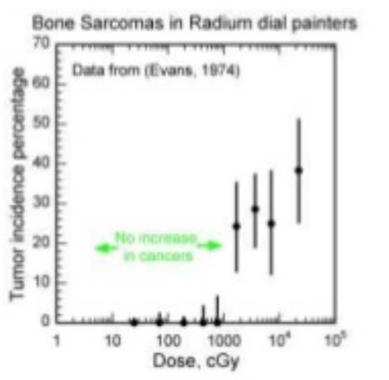
Case for a Threshold
Threshold: radium dial painters

Slide 27
Case for a Threshold
Conclusions:
General principles – behavior of radiation as a toxic substance is similar to other toxic substances
Low dose radiation is beneficial, and high dose is harmful, therefore a threshold between them must exist.
Thresholds for deterministic effects are known.

Slide 28
Case for a Threshold
Conclusions, continued:
Thresholds for development of carcinogenesis are identified.
Different tumors exhibit different thresholds.
Thresholds in humans probably range from (0.15 – 0.70 mSv (15 – 70 rem).
It appears reasonable that all low dose radiation effects have a threshold.

